Slide 1
Sargent / Assa Abloy Door Workstation Automation
Frank Prendergast
Notes:
This is an example of a Title Slide. We need to convey Life Is On in everything we do, so try to lead with compelling images that are vibrant, authentic, and human. The human element should be apparent and within the context of a segment that we touch.
To keep this PowerPoint template file size reduced, we included a small library of image choices in the Slide Master (under View). You can also get them from the SE Asset Library: https://schneiderelectric.telescopeondemand.com

Slide 2
Current WorkStation Layout Description
Each workstation has 24 bins that parts are taken from and assembled
Each of 24 Bins that have the materials to be assembled have a unique part number
Each door lock has a part number and consists of different number of parts from the bins
The operator performing the assembly needs to be guided as to which part they want to take next and to alarm if they take the wrong part.
Notes:
This is an example of a Text Slide. Reference the different layout options in the Slide Master (under the View tab) for different variations. Remember, our new Brand Guidelines call for clean and simple messages and design. Reference the PowerPoint Guidelines on the Brand Book for tips and useful information on creating effective presentations.

Slide 3
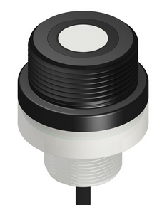
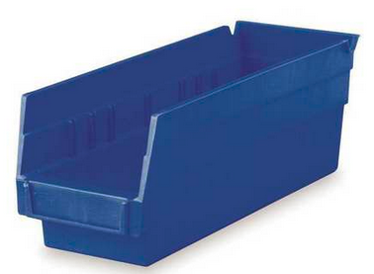


WorkStation Proposed Layout
Each bin will have a sensor on it with a light. Each lock will be bar code scanned into the PLC.
Light
Sensor
Bin
The operator will be instructed via the
light on the sensor of which bin to
take the part from.
There will be a horn and light for error.
And lights for confirmation of good part
Notes:
This is an example of a Text Slide. Reference the different layout options in the Slide Master (under the View tab) for different variations. Remember, our new Brand Guidelines call for clean and simple messages and design. Reference the PowerPoint Guidelines on the Brand Book for tips and useful information on creating effective presentations.

Slide 4
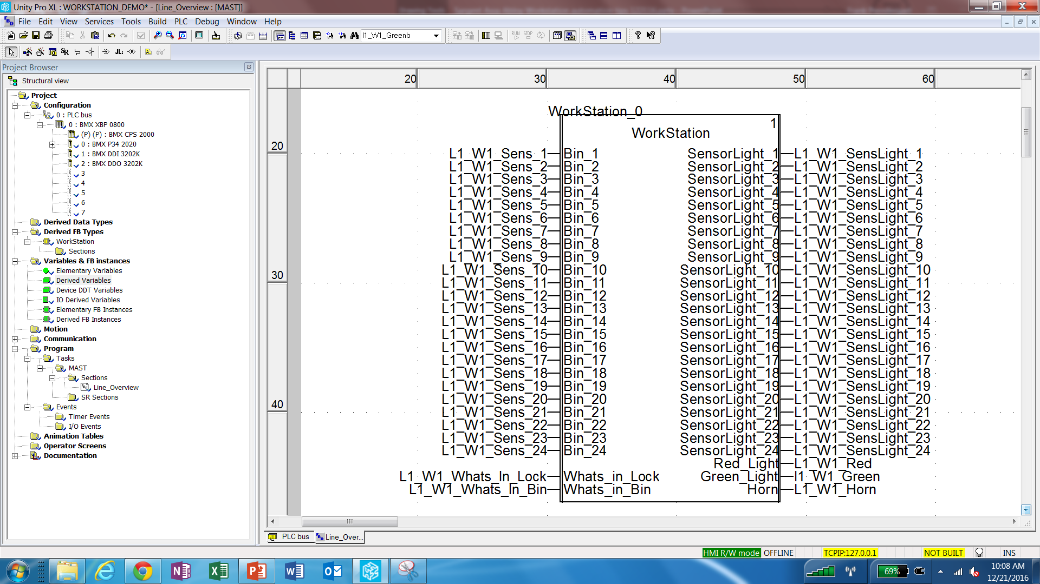
Unity software application
This Single Function Block
(called a Derived Function Block) is all you need
For the first workstation on the first line.
With one PLC you will have four of these blocks
that will do all the logic for the entire line
Bin inputs 1-24 are where you tie the particular
Sensor input to the particular Bin.
The Sensor Light output ties the light of the sensor
To the particular output from the PLC.
Whats_in_Lock is an array that has the Lock
part number and what parts are needed in each
Lock.
The next page shows the next level within this
DFB which has several sections
Using this methodology you just supply the part numbers of what are in
each bin and supply the Lock part number and what parts are in the lock
It is also flexible in that you can change the number of bins, etc.
Notes:
This is an example of a Text Slide. Reference the different layout options in the Slide Master (under the View tab) for different variations. Remember, our new Brand Guidelines call for clean and simple messages and design. Reference the PowerPoint Guidelines on the Brand Book for tips and useful information on creating effective presentations.

Slide 5
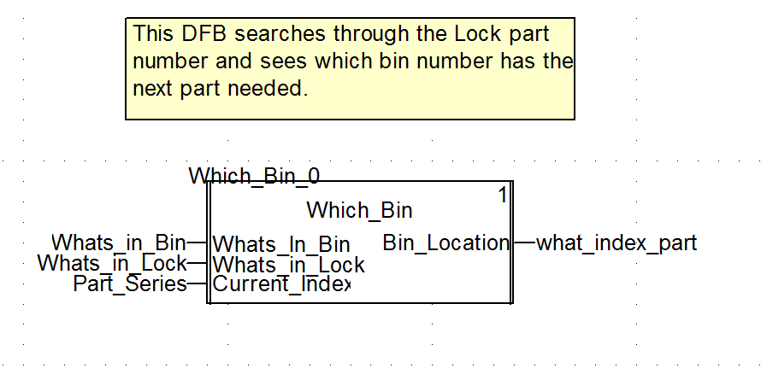
Unity software application Inside the Workstation DFB
This DFB is inside the Workstation DFB..
It does a search to find which bin is needed
next.
Whats_In_Bin is a single array of 24 Integers
Or Strings (depending upon your naming
convention for the items that are in the bin.
Whats_In_Lock is a double dimensioned array
that the first array is the lock numbers and then
Array beneath the first array is the listing of
Part numbers that are required for each lock.
Using this methodology you just supply the part numbers of what are in
each bin and supply the Lock part number and what parts are in the lock
Notes:
This is an example of a Text Slide. Reference the different layout options in the Slide Master (under the View tab) for different variations. Remember, our new Brand Guidelines call for clean and simple messages and design. Reference the PowerPoint Guidelines on the Brand Book for tips and useful information on creating effective presentations.

Slide 6
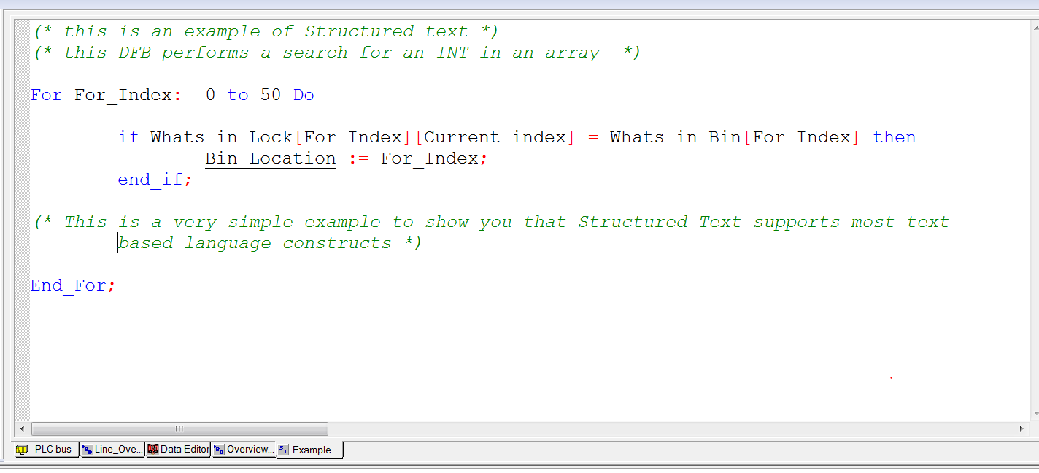
Example of Structure Text Programming
This Structured Text section is inside the
Which_Bin DFB which is inside the Work_Station
DFB in the application.
This is a very simple example to demonstrate that
Structured Text allows you to use For, Next, and
Do While loops along with Matrix and array
Manipulation, String evaluations, etc.
Notes:
This is an example of a Text Slide. Reference the different layout options in the Slide Master (under the View tab) for different variations. Remember, our new Brand Guidelines call for clean and simple messages and design. Reference the PowerPoint Guidelines on the Brand Book for tips and useful information on creating effective presentations.

Slide 7
Notes:
Section title with image slide

Slide 8
Notes:
Closing slide

